Slide 1

BookStore-API: A Comprehensive Guide
Explore the functionalities of the BookStore-API, designed for efficient management of user accounts and book data.

Slide 2
API Endpoints Overview
Register User
POST
/auth/register
Login User
POST
/auth/login
Add Book
POST
/books
Update Book
PUT
/books/{BookID}
Get Book by ID
GET
/books/{BookID}
Search By Genre
GET
/books/search?genre={genre}
Delete Book
DELETE
/books/{BookID}

Slide 3
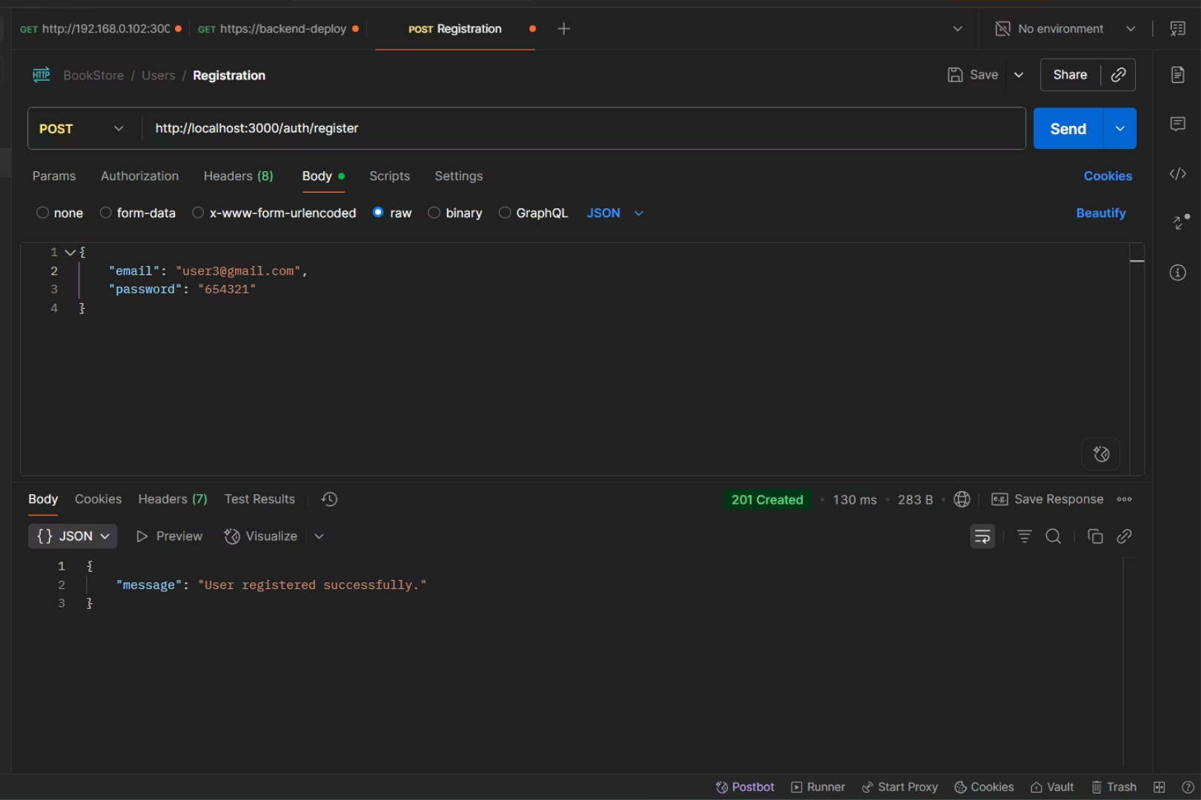
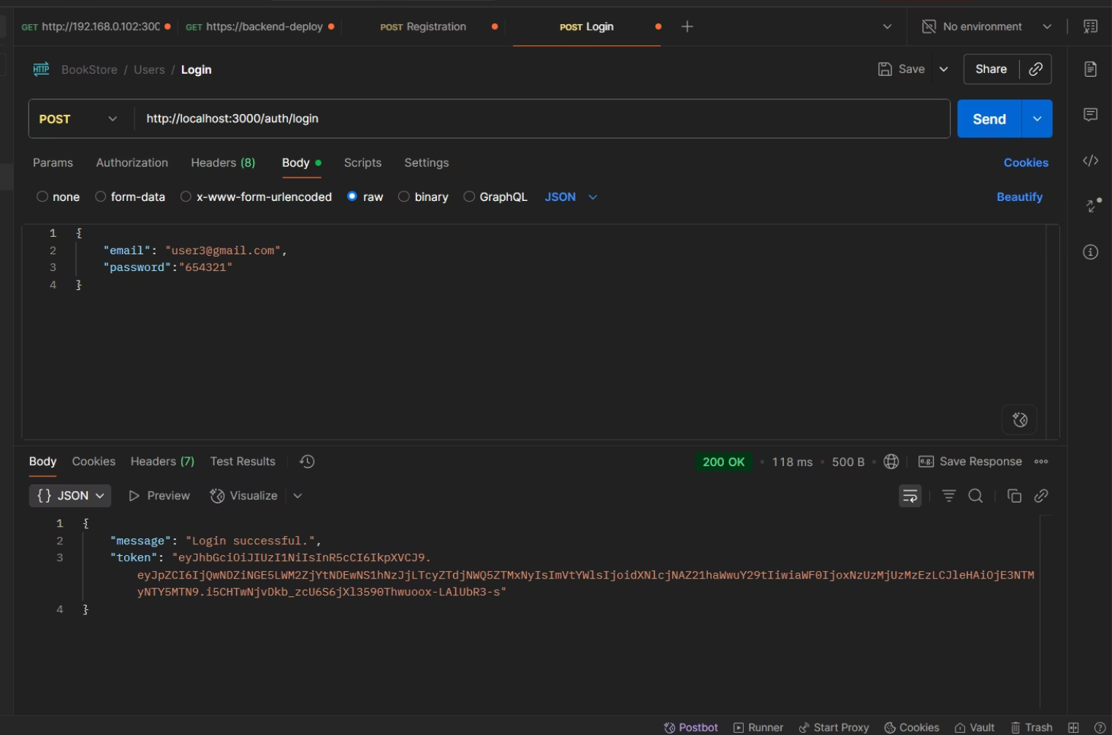
User API: Register & Login
Register User (POST)
Login User (POST)
Create a new user account by submitting valid credentials (email, password) in JSON format via the Body tab in Postman.
Log in using the same procedure as registration. A successful login returns a JWT token for authorization.

Slide 4
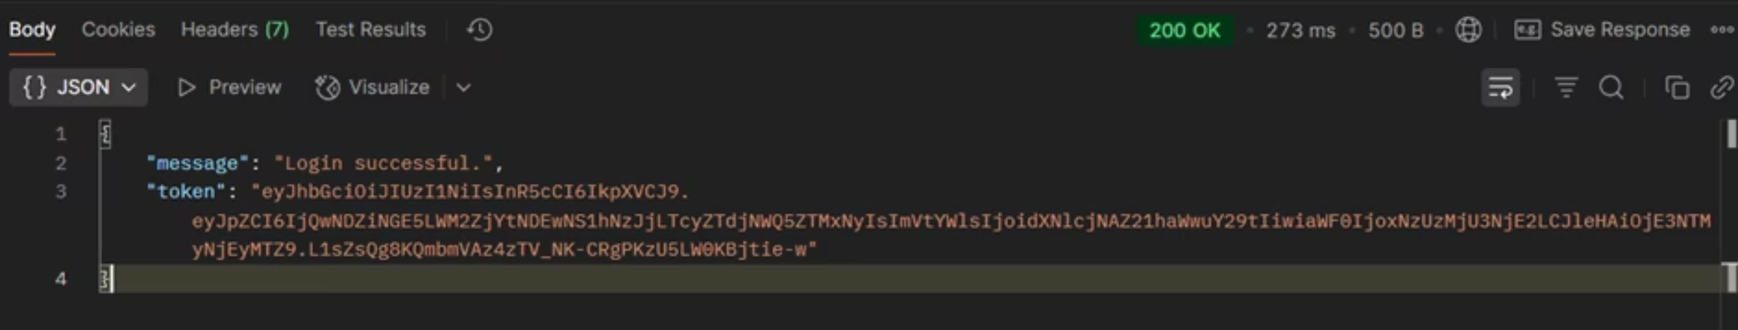

Authorization with JWT Token
After successful login, retrieve the JWT token. This token is essential for authenticating all subsequent API requests (GET, POST, PUT, DELETE), particularly for protected routes for book operations.
How to Use: Add the token to the request header as: Authorization: Bearer <your_token_here>

Slide 5
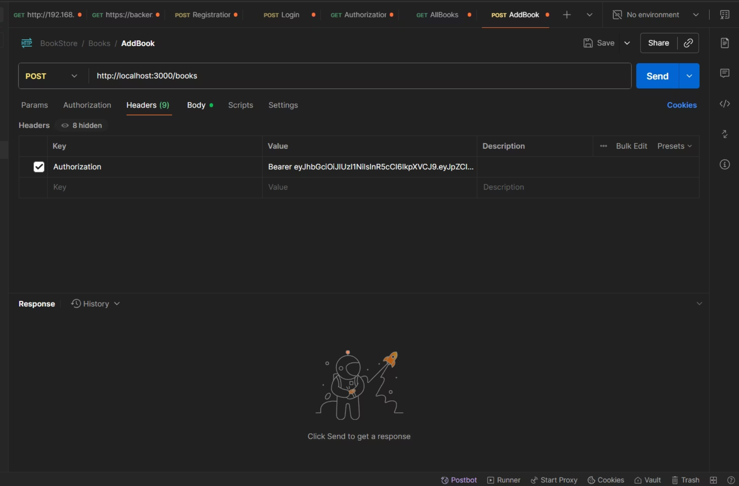
Book API: Add Book
Step 1: Authorize Request
To make any book API call, including adding a book, first add the JWT token to the "Headers" tab in Postman. Set the Key to "Authorization" and the Value to "Bearer <your_token_here>". This token authenticates your request for all book-specific operations.
Example:
Key: Authorization
Value:
Bearer eyJhbGciOiJIUzI1NiIsInR5cCI6IkpXVCJ9.eyJpZCI6IjQwNDZiNGE5LWM2ZjYtNDEw...

Slide 6
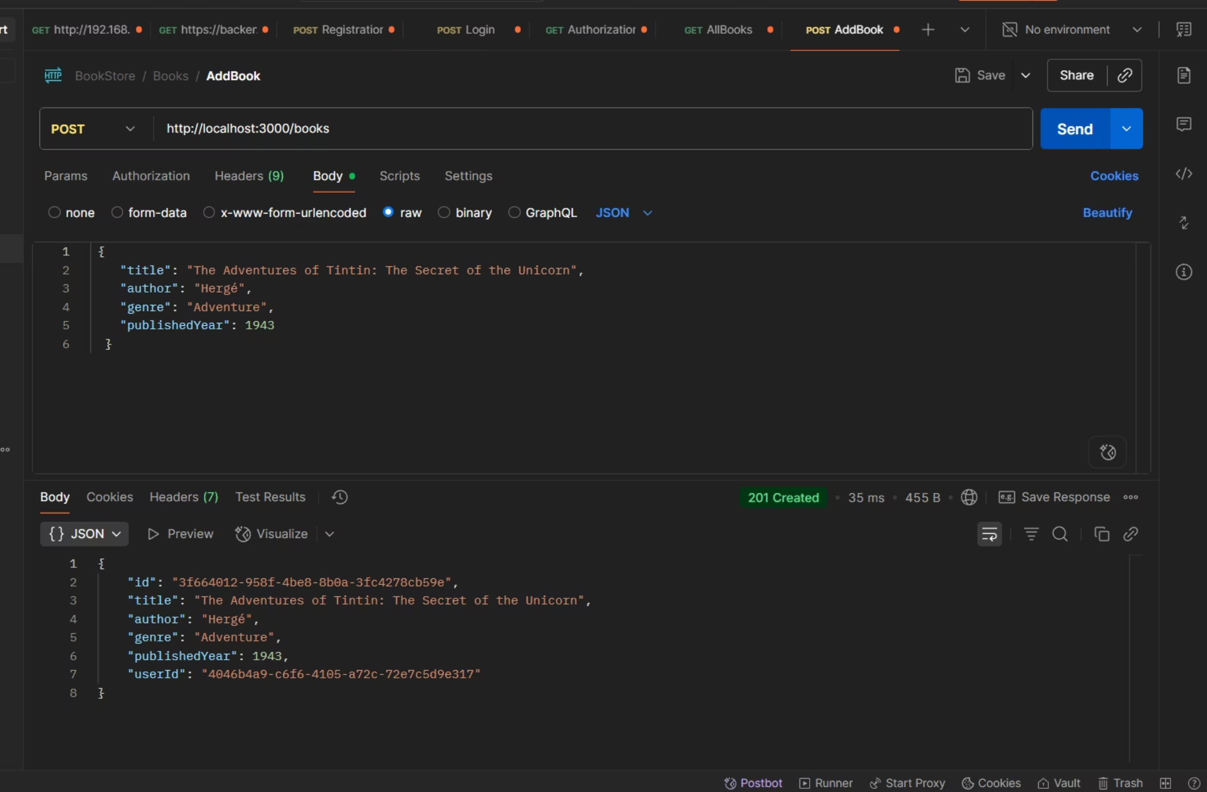

Step 2: Add Book Details
In the Body section, add book details in JSON format (title, author, genre, publishedYear).
Endpoint Request Body Example:
POST /books

Slide 7
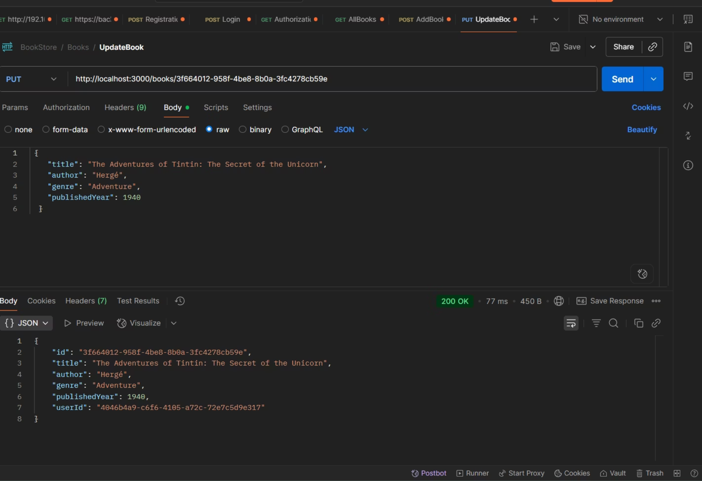

Book API: Update Book
To update an existing book, you must include the Authorization header and provide the unique BookID, which is issued when the book is first created.
Endpoint: PUT /books/{BookID}
Example:http://localhost:3000/books/58bdd207-83d2-4146-a73d-9262b7bd481a

Slide 8
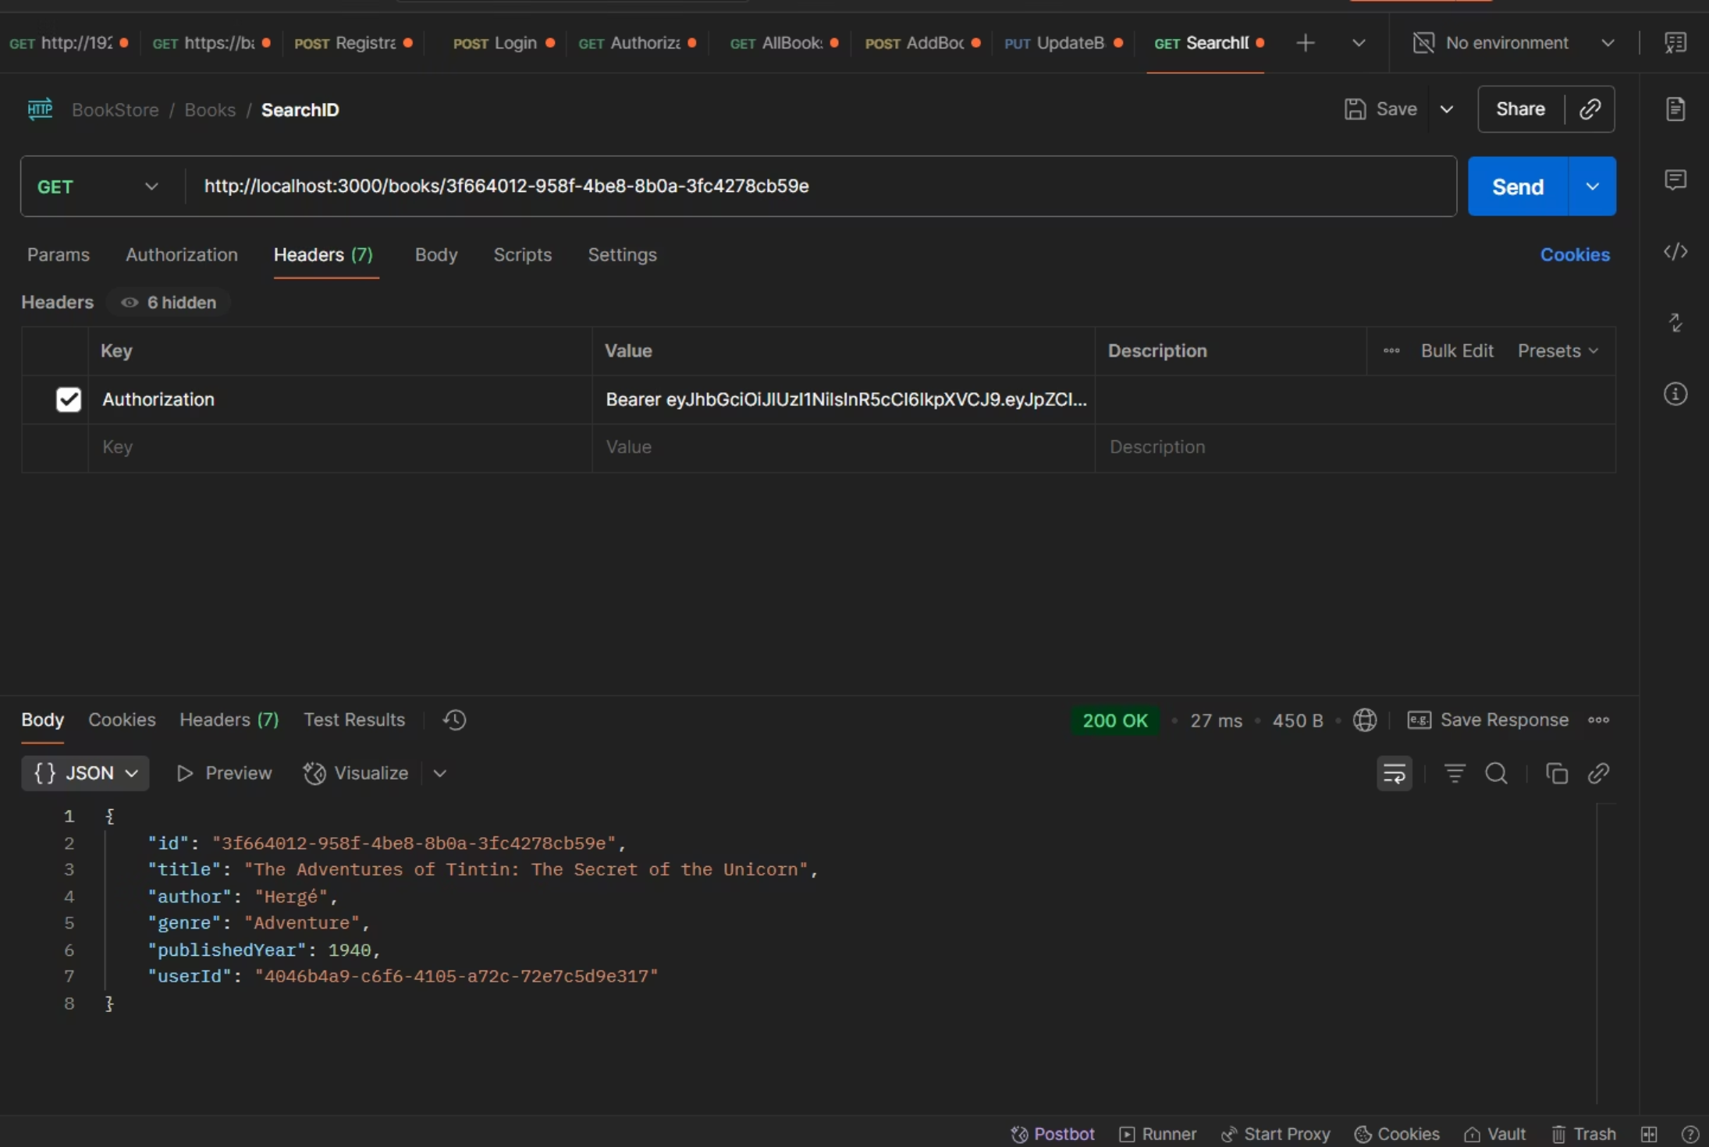

Book API: Search Books
Search By ID (GET)
To retrieve a specific book, you must include the Authorization header and its unique BookID.
Endpoint: GET /books/{BookID}

Slide 9
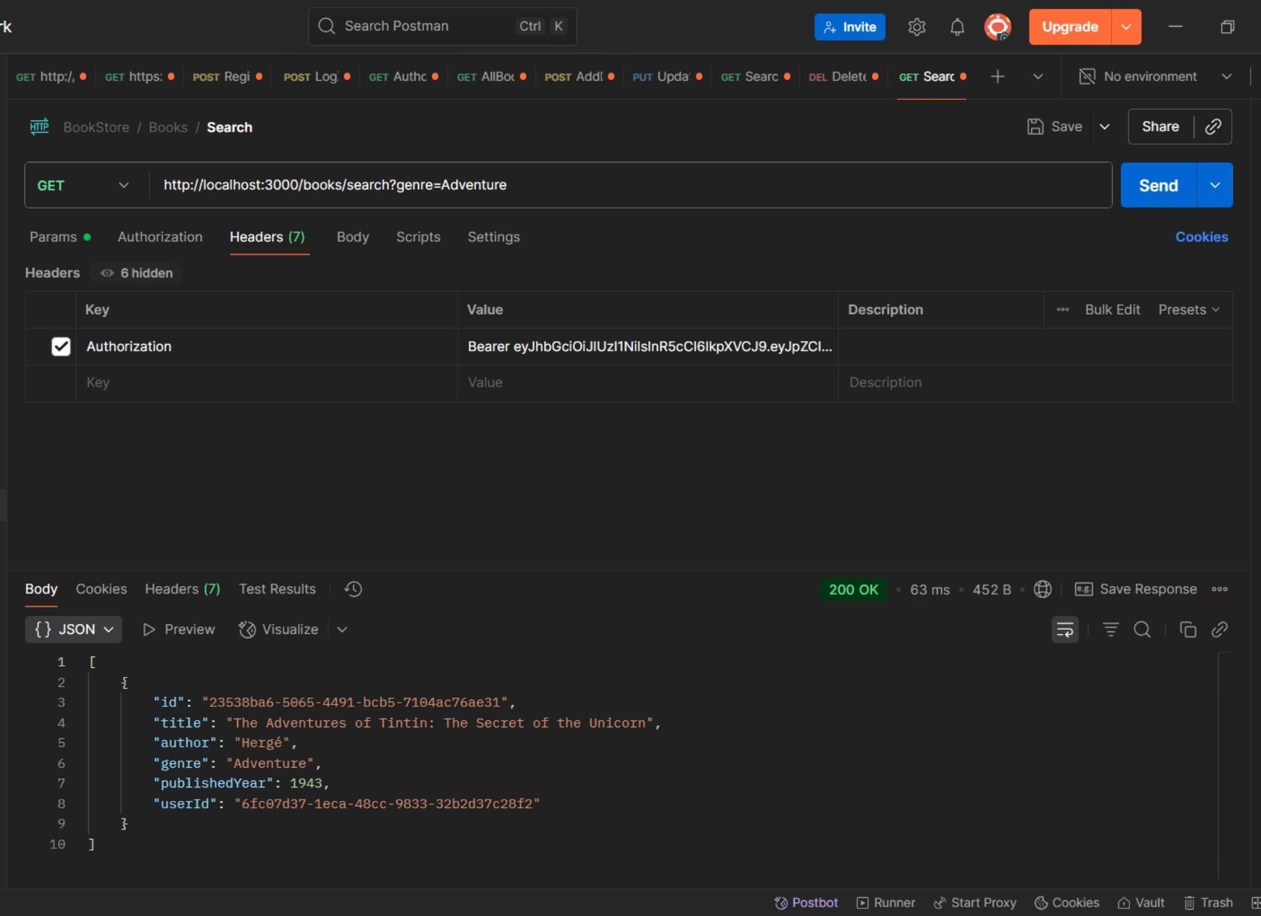
Search By Genre (GET)
Retrieve a list of books matching a specific genre by including the Authorization header and passing the genre as a query parameter.
Endpoint: GET /books/search?genre={genre}

Slide 10
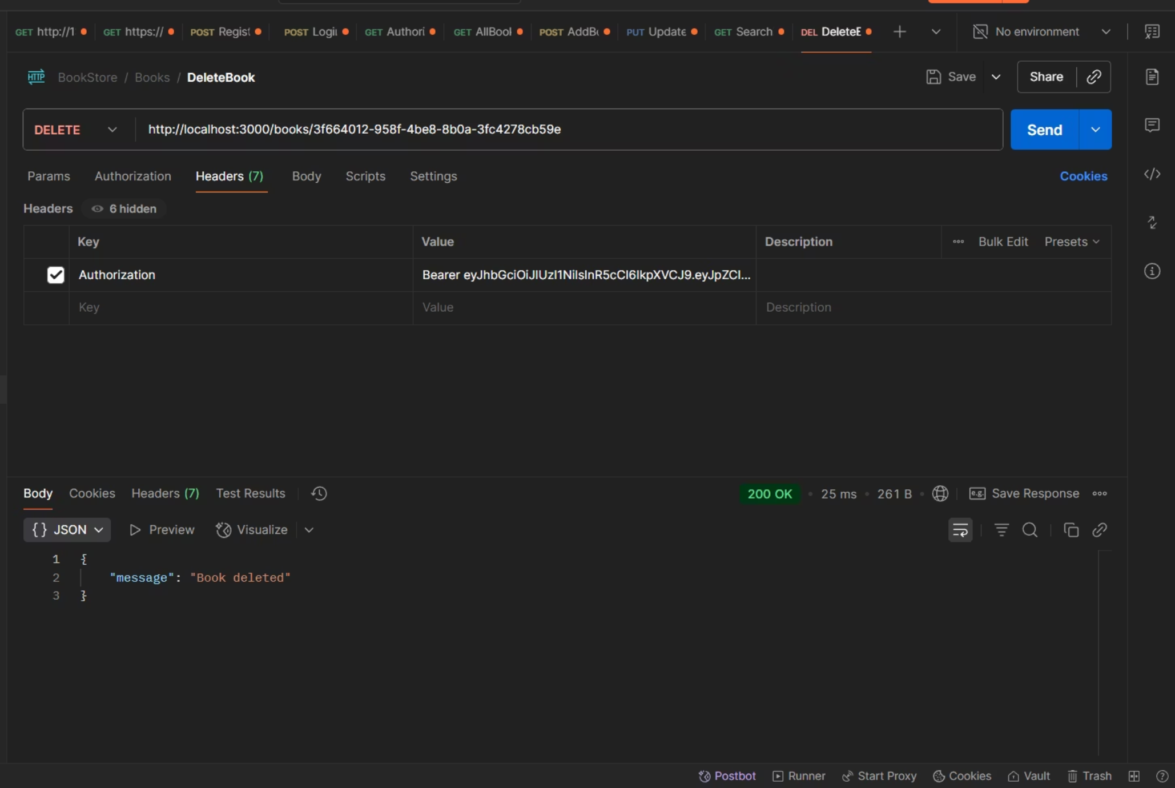

Book API: Delete Book
To remove a book from the database, use the DELETE method with its unique BookID and include the Authorization header.
Endpoint: DELETE /books/{BookID}

Slide 11
Auth API Testing Summary
Objective: Verify registration and login functionality with both valid and invalid credentials.
Test Cases:
✅ Register User: POST /auth/register → expects 201 & success message
✅ Login (Valid): POST /auth/login → expects 200 & returns JWT token
❌ Login (Invalid): wrong credentials → expects 401 & error message

Slide 12
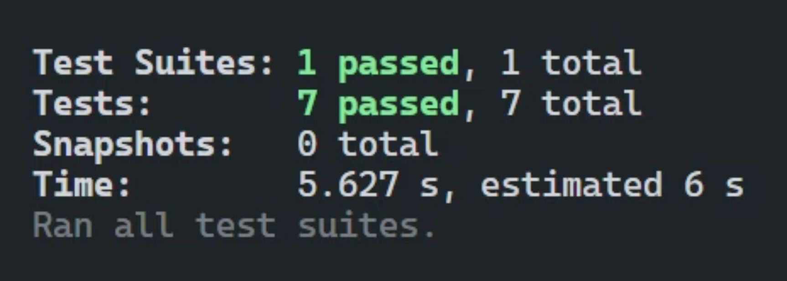
Book API – Test Summary
Objective: Test complete book management flow with authorization.
Test Cases:
✅ Create Book: Adds a book → expects 201 Created
✅ Get Books: Retrieves list → expects 200 OK + array
✅ Update Book: Modifies existing entry → expects 200 OK
✅ Delete Book: Deletes entry → expects 200 OK

Slide 13

Certificate

Slide 14

.

Slide 15




Contact & Repository
Explore the source code and contribute to the project on GitHub:
https://github.com/Imemyslf/Bookstore-API
Connect with the Author:
Name: Kishan Sharma
Contact: +91 8830458122
Email: k3004022@gmail.com
LinkedIn: https://www.linkedin.com/in/kishan-sharma-709750201/

